Slide 1
Million Song Data Set Predictive Analysis using Regression Techniques
By:-
Yash Chaudhry
Akul Rastogi
CSE - C
CSE - A
149105420
149105416

Slide 2
Introduction
What are today’s world hot requirements? What are people competing for?
-Data Science, Machine Learning, Scripting
Machine learning –
-“Are We Living in a Computer Simulation?”
-Could WE Be The Machines Then, That Are Actually Developing And Training Other Machines To Do What We Do EVERYDAY And EVERY SECOND?
Data Analysis –
-Data analysis is a method in which data is collected and organized so that one can derive helpful information from it.

Slide 3
Million Song Data Set
Million song dataset is a freely-available collection of audio features and metadata for a million contemporary popular music tracks
Attractive features of the Million Song Database include the range of existing resources to which it is linked, and the fact that it is the largest current research dataset in the ﬁeld.
Million Song Dataset is actually becoming the natural choice for researchers wanting to try out ideas and algorithms on a data that is standardized, easily obtained from UCI Machine Learning Repository, and relevant to both academia and industry

Slide 4
Notable Features/Attributes of MSD
Duration
Loudness
Hotness
Tempo
Title Length
Familiarity
Available Features Count : 90

Slide 5
Problem Statement
Predict the release year of a song by developing and training regression models using features/attributes of the songs.

Slide 6
Objective Evolution After Literature Review :-
Understanding the importance of creation of large dataset.
Analyzing the constituents of MSD dataset.
Understanding the recent trend/liking towards music by people.
Finding correlations among the constituent for accurate predictability.
Developing a prediction algorithm that scales to commercial size.

Slide 7
Design Methodology, Algorithm and Techniques
Python 2.7 with Spark, Numpy, Pyplot APIs, produced in Jupyter Notebook
Baseline – Average Label Model
Linear Regression Model via Gradient Descent
Linear Regression Model via Stochastic Gradient Descent
Grid Search to find better regularization parameters

Slide 8
Why these specific Technologies?
Spark
Uses memory instead of network and disk I/O which makes it relatively faster than Hadoop.
Python
Hottest IT company requirement in scripting languages.
It is a general purpose language, which means it can be used to build just about anything
Numpy &Pyplot
NumPy is the fundamental package for scientific computing with Python
Pylpot functions makes matplotlib library work like MATLAB (a multi-paradigm numerical computing environment)

Slide 9
Individual Contribution
Akul Rastogi -
R Tutorials
Trend Deduction in Data Analysis
Raw data parsing and integrity check
Unit testing modules
Baseline Model Implementation
Gradient Descent Implementation
Yash Chaudhry -
Internshala Data Analytics Course
Statistical Analysis in Data Analysis
Pyplot Visualizations
Training, validation & test data set definition
Stochastic Gradient Descent Implementation
Grid Search Implementation

Slide 10
Sequence Of Steps To Solve The Problem

Slide 11
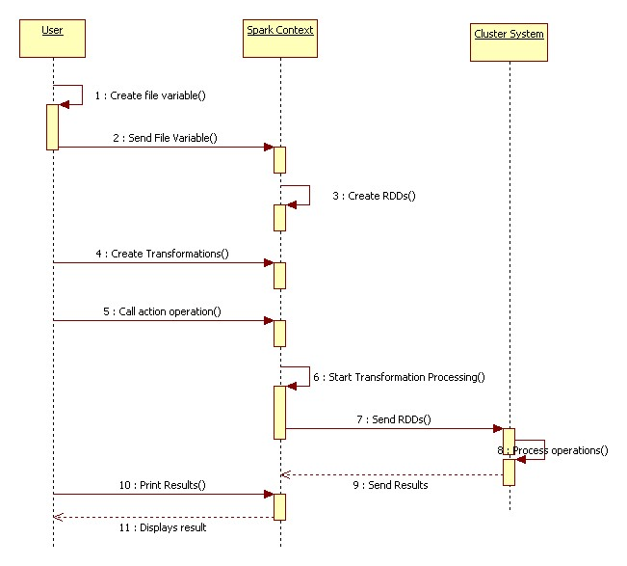
This Sequence Diagram depicts the working of Spark to process operations.

Slide 12
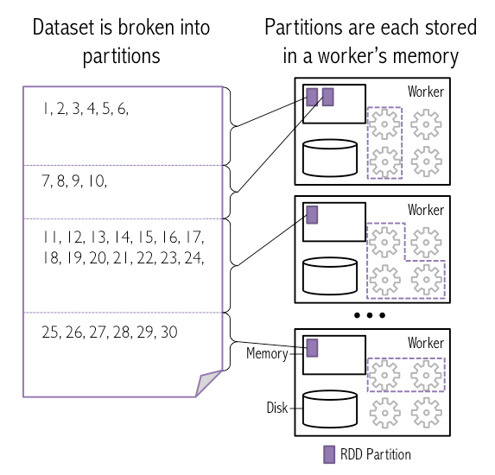
This figure depicts the creation and storage of RDDs from Dataset

Slide 13
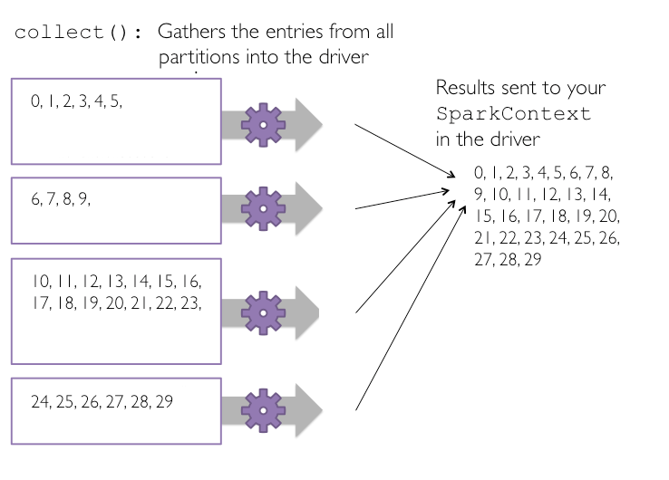
Figure Depicts action operation (collect).
Action operations cause Spark to perform the transformation operations that are required to compute the RDD returned by the action.

Slide 14
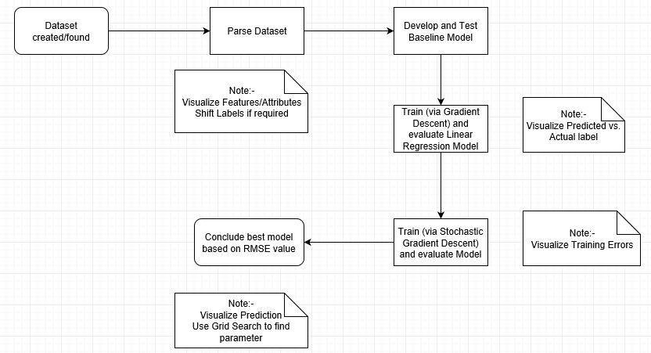
Flowchart

Slide 15
Results & Inferences

Slide 16
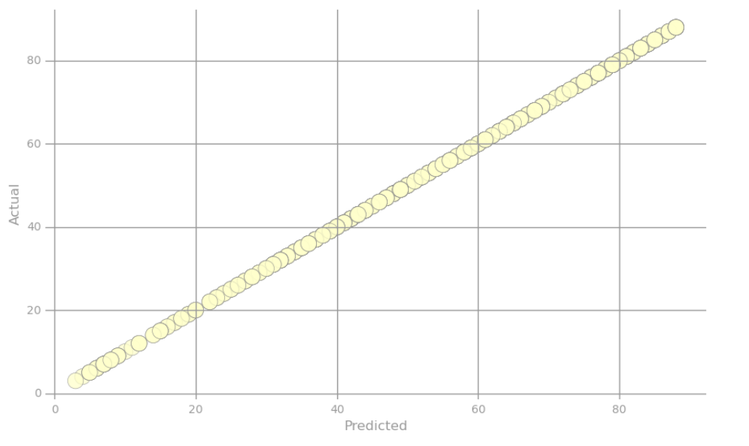
Ideal Situation
Inference :-
The scatter plot represents the ideal situation where the predicted value exactly equals the true label.

Slide 17
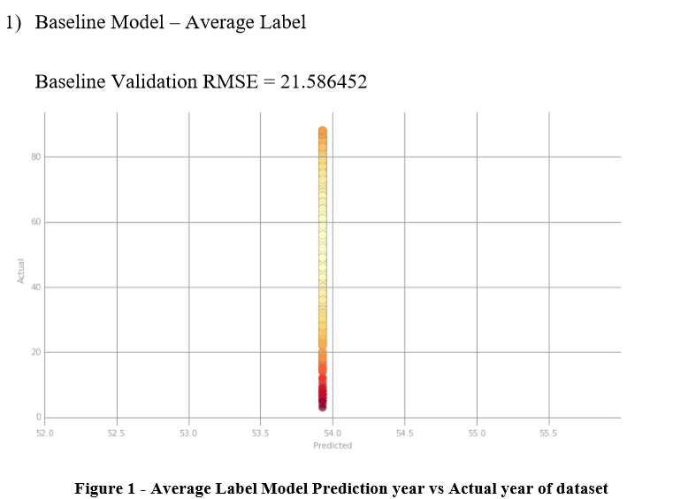
Inference :-
This scatter plot uses Baseline Prediction Model (Average Trained Year).
Also the points in the scatter plots are color-coded, ranging from light yellow when they are true and predicted values are equal to bright red when they drastically differ.

Slide 18
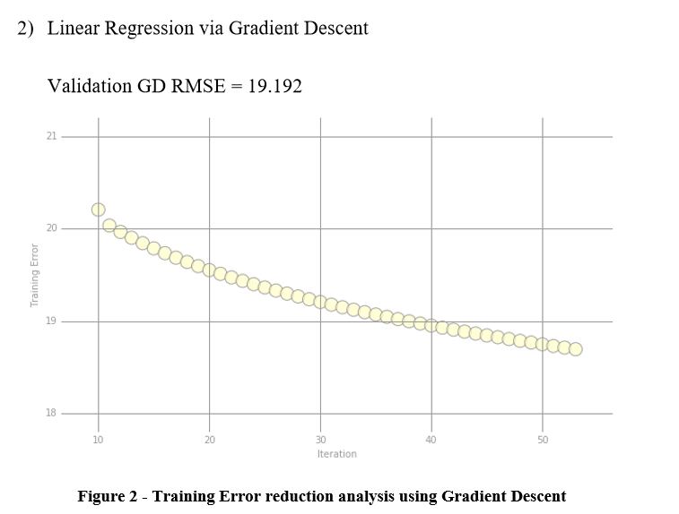
Inference :-
This scatter plot shows Training Error as a function of Iteration.
Errors reduce as the number of iterations are increased to calculate more appropriate or accurate weights for Gradient Descent algorithm.

Slide 19
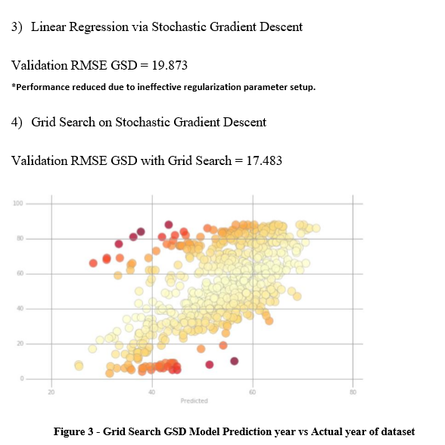
Inference :-
Stochastic Gradient Descent without good regularization parameter decision doesn’t perform so well in comparison to Vanilla Gradient Descent .
With Grid Search implementation on SGD we are significantly able to reduce the Root Mean Square Error.
A color-coded scatter plot visualizing the predicted value from this model against true label.

Slide 20
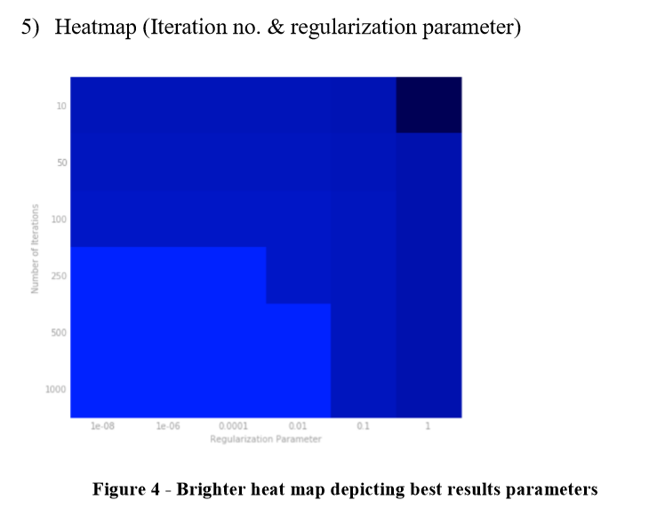
Inference :-
The plot represents a heat map where the brighter colors correspond to lower RMSE values for regularization parameter against No. of Iterations.

Slide 21
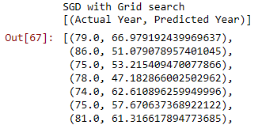
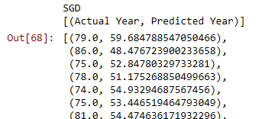
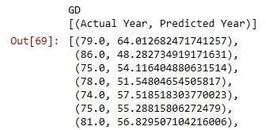
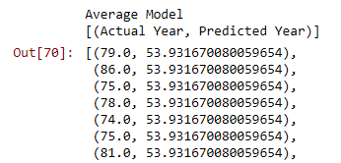
Iterations = 700
*Note – Increase the number of Iterations for better weight calculations.

Slide 22
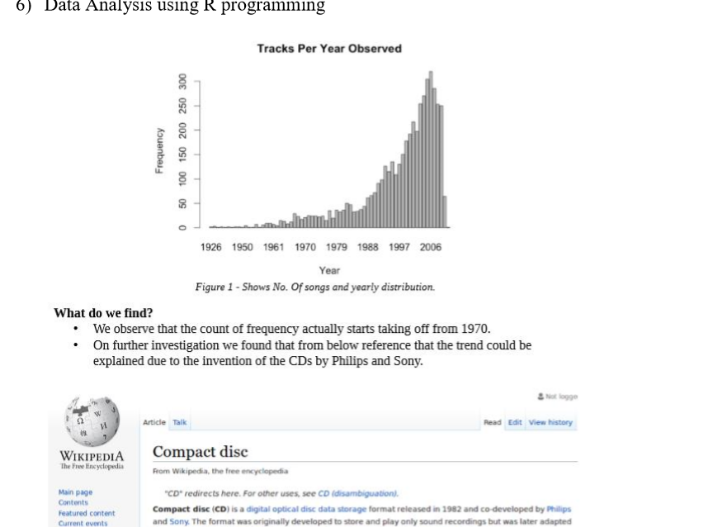
Inference :-
A simple histogram depicting Frequency of songs in an year.
Frequency starts taking off from 1970 and surging in 1980s
Compact Disk released in 1982 developed by Sony and Philips? Could this have a hand in music surge?

Slide 23
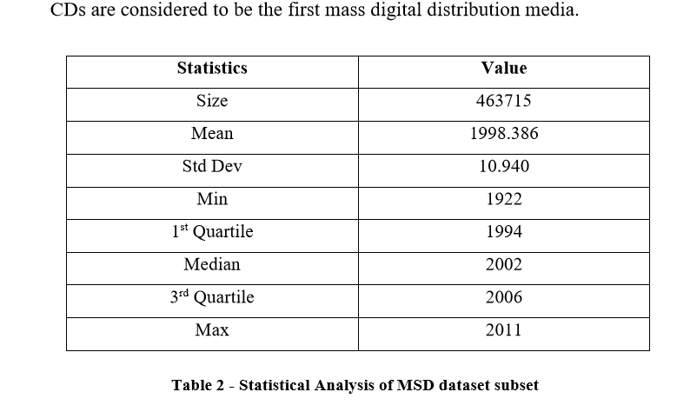
Inference :-
Number crunching statistics to know what we are dealing with. Some of them :-
Size of Dataset
Standard Deviation
Quartile Knowledge

Slide 24
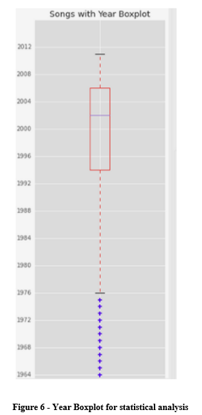
Observations -
We can observe that we get a negative skew, a left skewed graph from histogram.
Central mass of distribution lies between the mid 1990 to mid 2000s
Song proportion from 1922 to 1976 is barely 5% of sample data.
Peak count song year comes out to be 2007.
2007 was the release year of 1st Generation iPhone

Slide 25
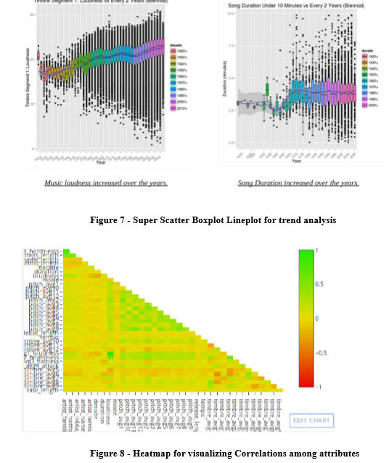
Highly correlated features:
Loudness vs. Familiarity (Louder the better?)
Hotness vs. Familiarity (More familiar more hot?)

Slide 26
Conclusion
Stochastic Gradient Descent with Grid Search outperformed, in predicting the year of a music record, all the other analysis algorithms tested so far by providing the least Root Mean Square Error.
By Data Analysis one learns about the evolution in trending music which ofcourse can be used by music record companies to produce profitable music.

Slide 27
Proposed Work Plan for future
Implementation of following techniques can produce comparable or even better results:
2 Way Interaction Model – Examine Variable combination which affects response
Gaussian Process Model Neural network - Avoiding local minima in neural networks
Nonlinear Conjugate Gradient - Very successful in regression - O(n)
L-BFGS - Uses Hessian approximation
Levenberg-Marquardt Algorithm - Best optimization algorithm but O(n^3)

Slide 28
Other Analysis domain for MSD
Metadata analysis
Artist recognition from the audio
Automatic music tagging
Recommendations and similarity findings
Cover song recognition
Mood prediction based on lyrics.

Slide 29
References
[1] Million Song Dataset, official website by Thierry Bertin-Mahieux, available at: https://labrosa.ee.columbia.edu/millionsong/
[2] Thierry Bertin-Mahieux, Daniel P.W. Ellis, Brian Whitman, Paul Lamere THE MILLION SONG DATASET 12th International Society for Music Information Retrieval Conference (ISMIR 2011) http://ismir2011.ismir.net/papers/OS6-1.pdf
[3] Wikipedia https://en.wikipedia.org/wiki/Gradient_descent
[4] Sebastian Ruder http://ruder.io/optimizing-gradient-descent/
[5] Hackerearth http://blog.hackerearth.com/gradient-descent-algorithm-linear-regression
[6] Stackoverflow https://stackoverflow.com/questions/33621399/understanding-gradient-of-gradient-descentalgorithm-in-numpy
[7] Analytics Vidhya https://www.analyticsvidhya.com/blog/2017/03/introduction-to-gradient-descent-algorithmalong-its-variants/
[8] LearnR https://github.com/rstudio/learnr
[9] Anthony D Jospeh Spark Tutorial Berkeley https://www.edx.org/course/big-data-analysis-apache-spark-ucberkeleyx-cs110x
[10] Evanz Machine Learning tutorial https://github.com/EvanZ/myvagrant
[11] Ujjwalkarn Machine Learning & R Tutoial https://github.com/ujjwalkarn/DataScienceR
[12] Python Pyplot Tutorial https://matplotlib.org/users/pyplot_tutorial.html
[13] Matt Nedrich https://github.com/mattnedrich/GradientDescentExample
[14] Spark Documentation https://spark.apache.org/docs/1.1.1/api/java/org/apache/spark/mllib/regression/LinearRegressionWithSGD.html

Slide 30
Thank you!

